Slide 1

Visualization of operations on tree data structures:
20232.OOP.Mini-Project.Group04
Lecturer: Prof.Nguyen Thi Thu Trang

Slide 2
Members & assignment
Phan Viet Anh – 20225566: implement the tree screen controller class, make report and slide.
Nguyen The Hung – 20225573: design class diagram, implement the main menu, tree screen and main menu controller class, complete the report
Le Hai Nhat – 20225583: implement the algorithm class of the tree data structure, complete the report, GUI and final code modify.

Slide 3
Problem Statement
The project titled “Visualization of Operations on Tree Data Structures” is a Java-based graphical application that visually illustrates different operations on tree data structures. The aim of this project is to aid users in gaining a deeper understanding of the functioning of tree data structures and the impact of various operations on them. In this project, an application is developed that allows a user to select and visualize one of the four types of tree data structures: general, binary, balanced tree, and balanced binary tree. The operation menu offers six options: create tree, insert node, delete node, update node, search node, and traverse node.

Slide 4
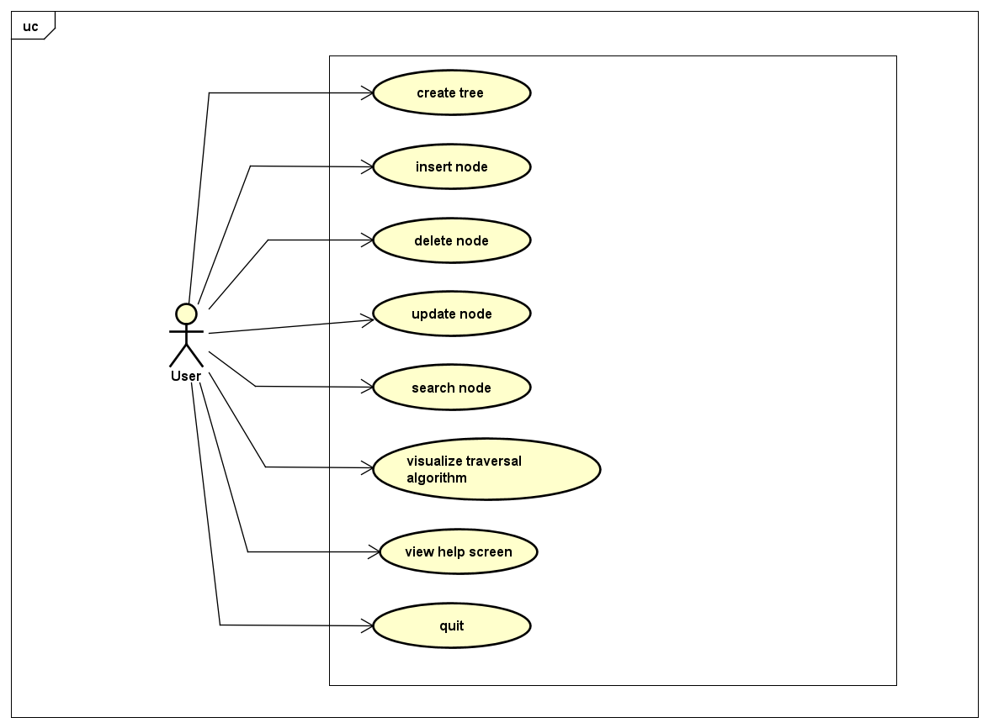
Usecase Diagram

Slide 5
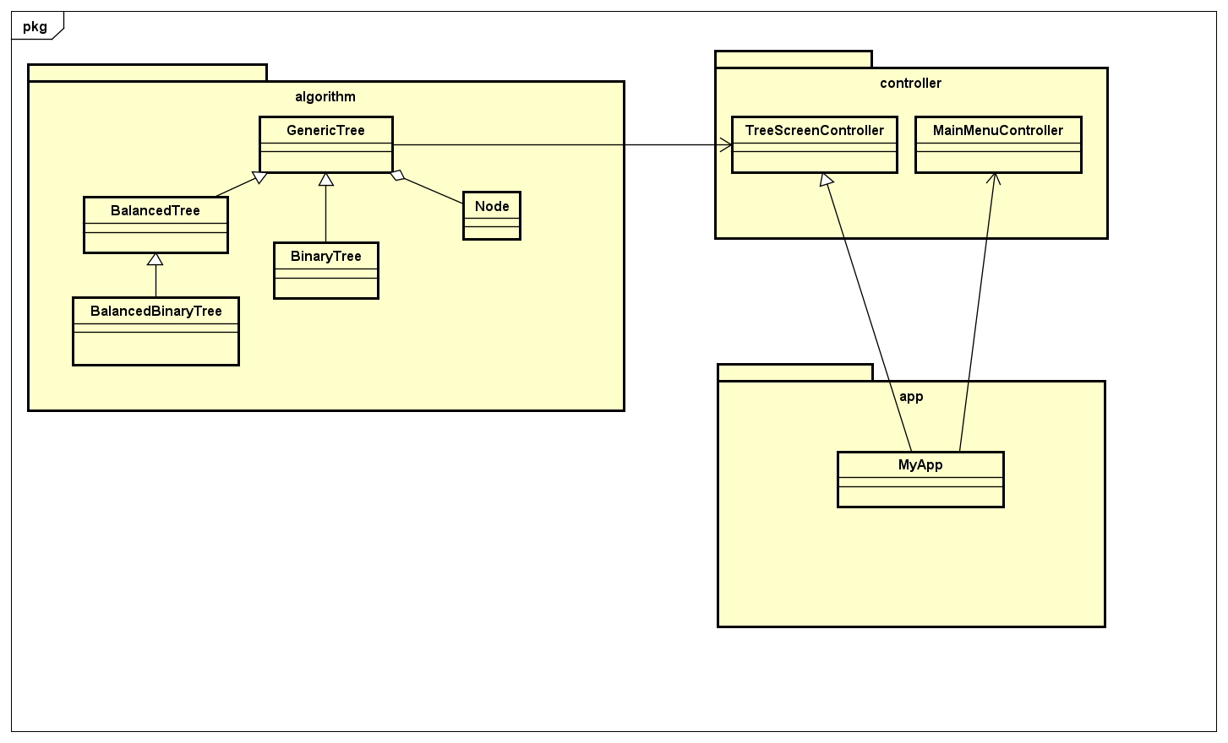
General Class Diagram

Slide 6
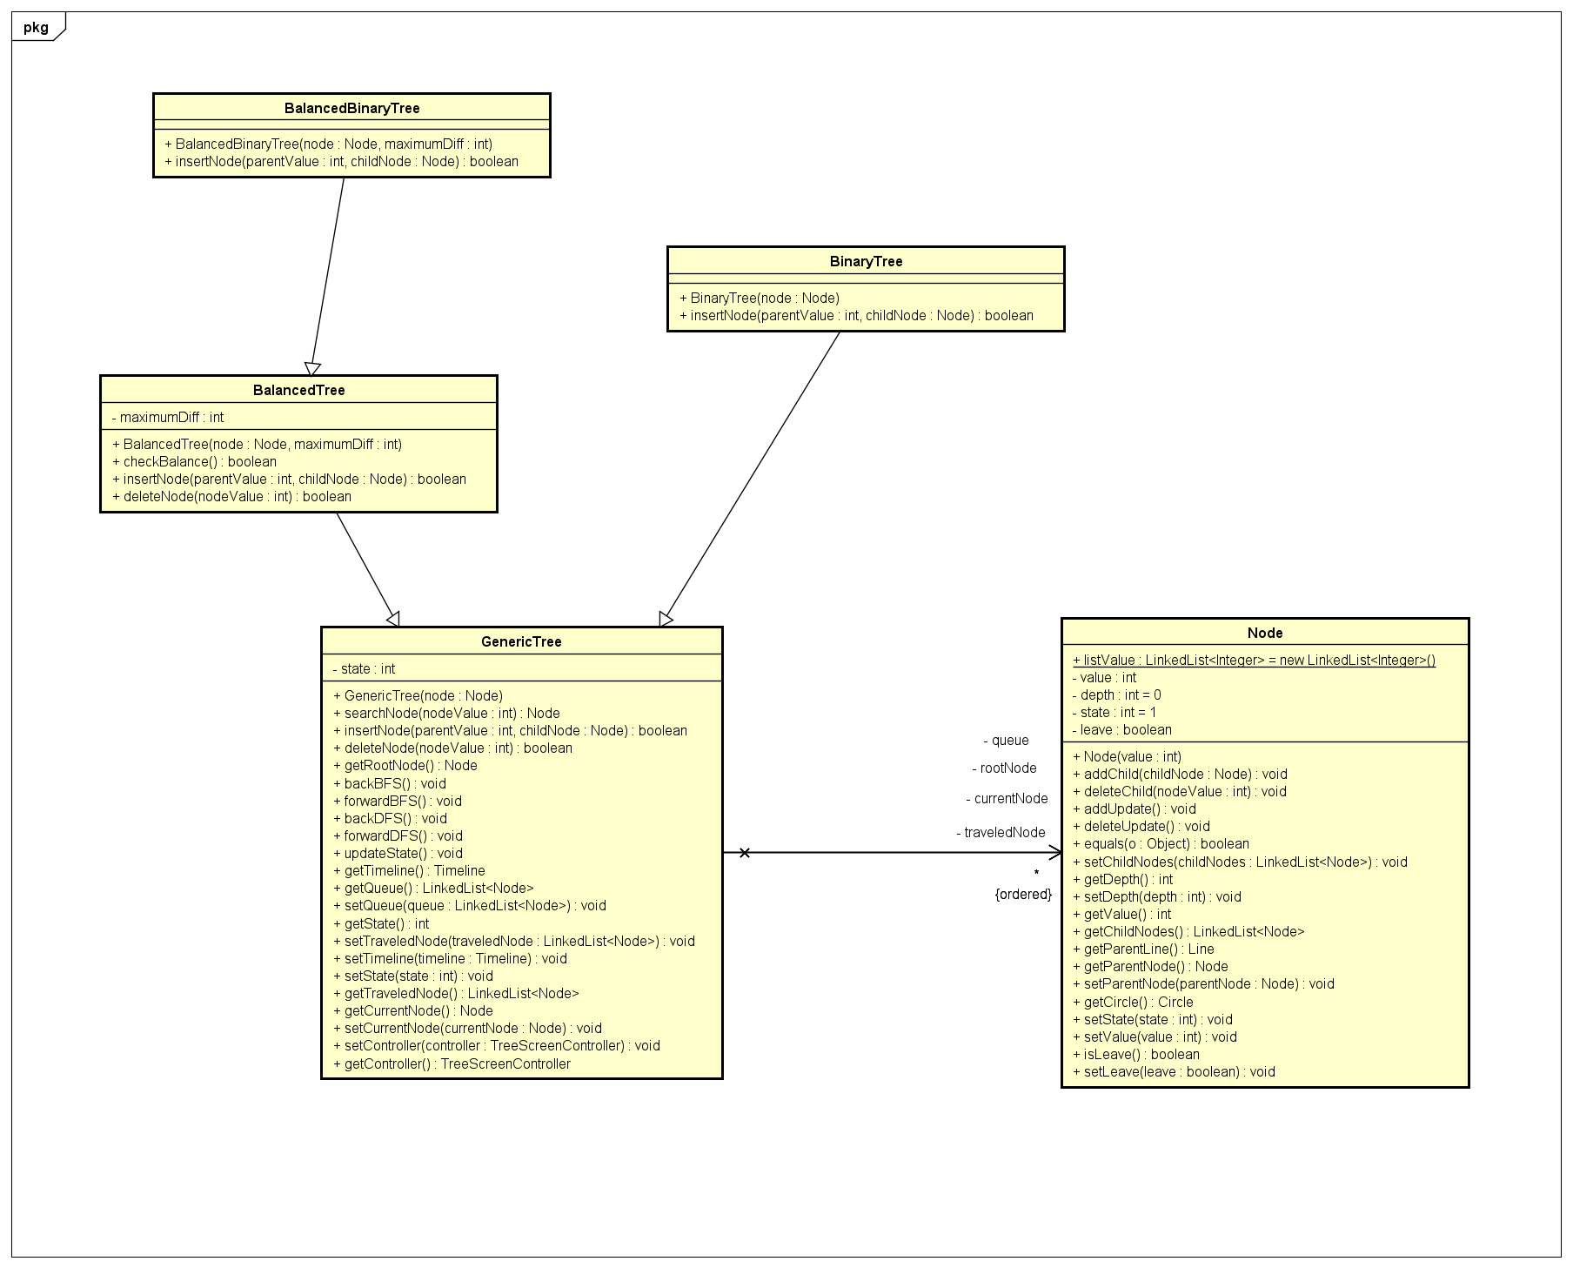
Class Diagram for packages
Class Diagram for Algorithm package:

Slide 7
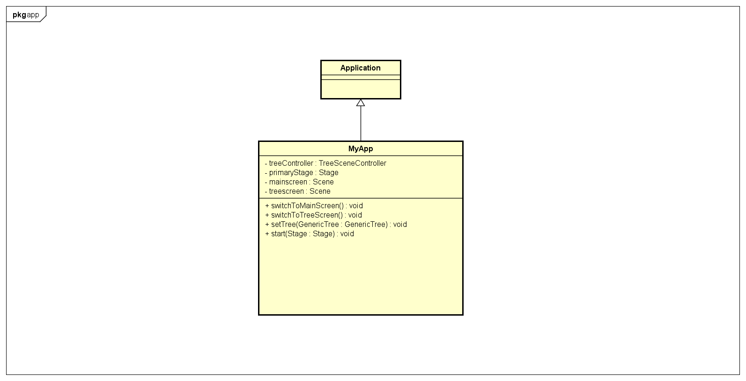
Class Diagram for packages
Class Diagram for App package:

Slide 8
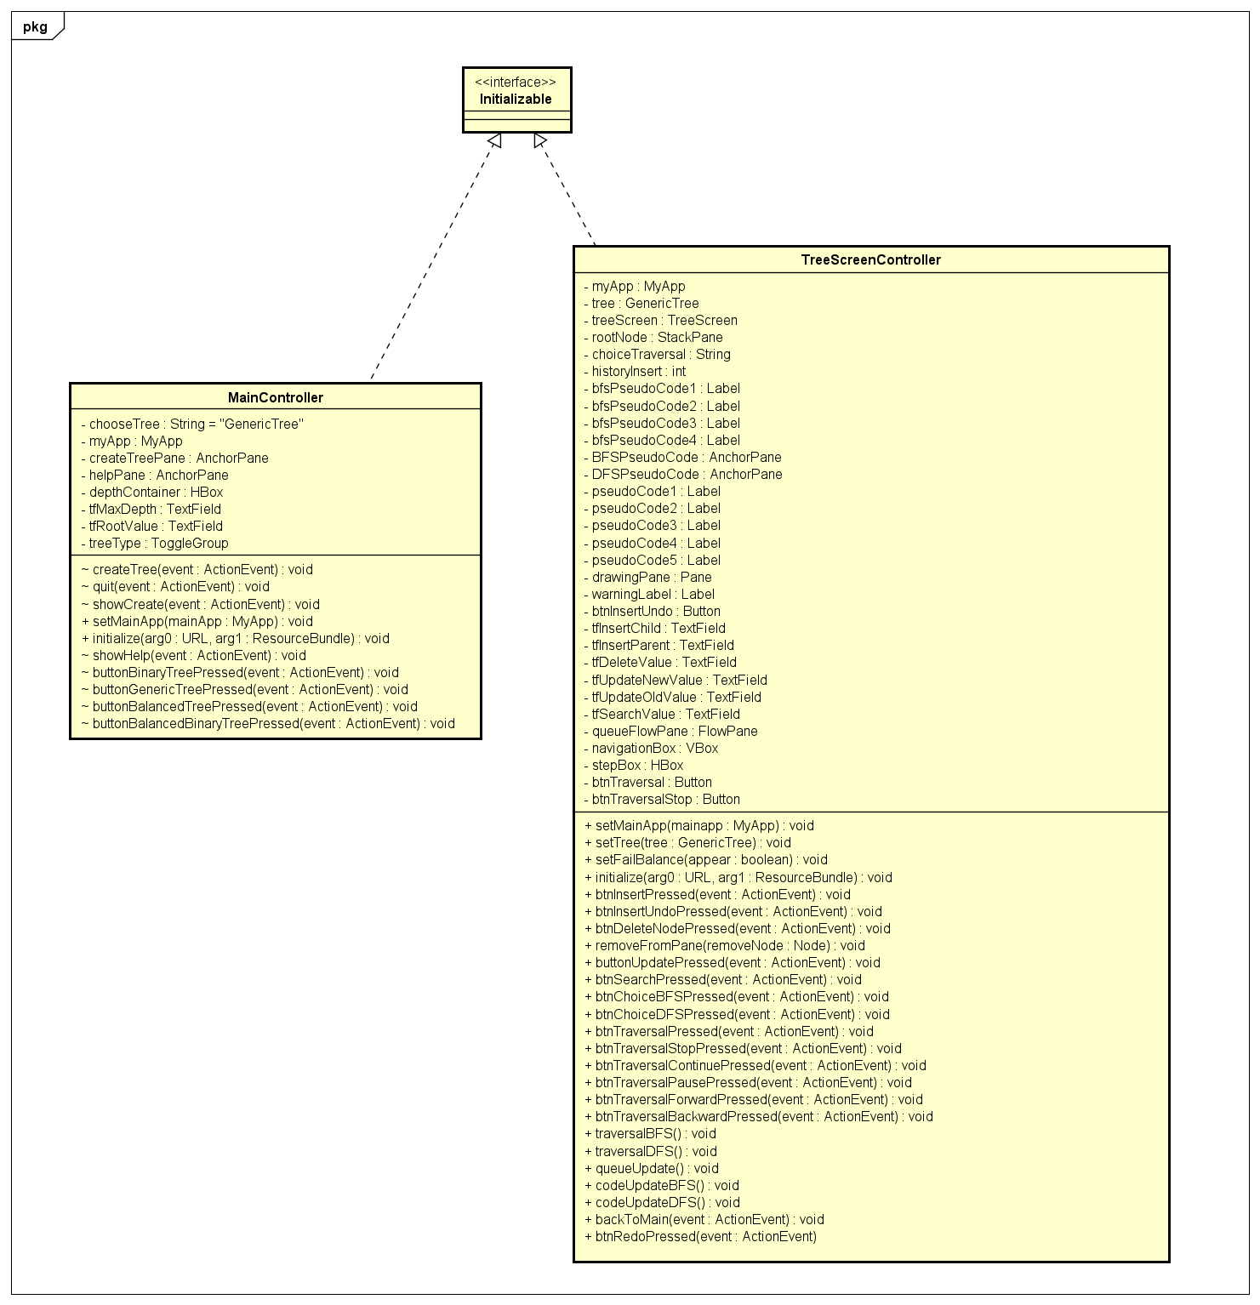
Class Diagram for packages
Class Diagram for Controller package:

Slide 9
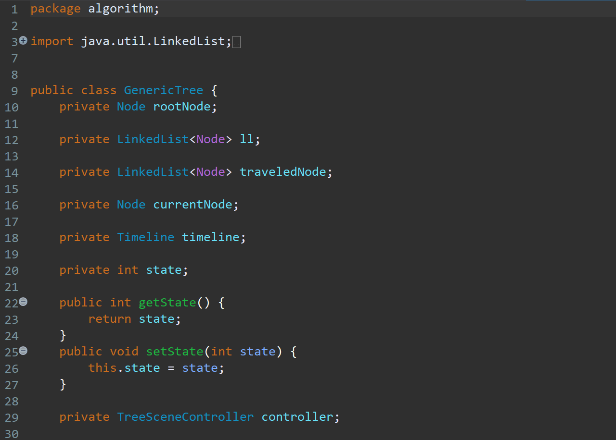
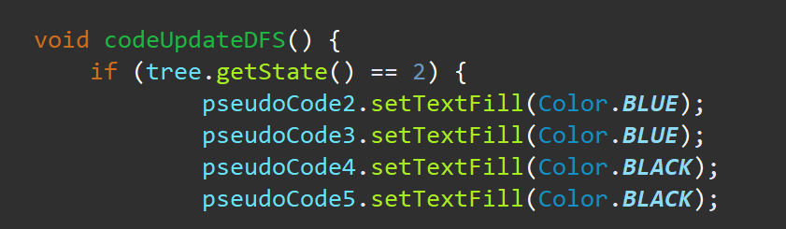
Explanation of OOP techniques
Encapsulation
Technically in encapsulation, the variables or data of the GenericTree class is hidden from any other class and can be accessed only through any member function of its own class in which it is declared.
EX: The getState method is used in the TreeScreenController class to access the state variables of the GenericTree class.

Slide 10
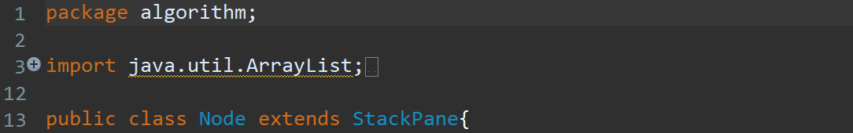
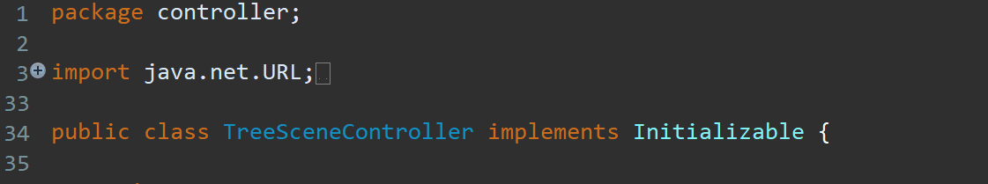
Explanation of OOP techniques
Single Inheritance
In single inheritance, subclasses inherit the features of one superclass. In the image below, StackPane class and Initializable class – which is a JavaFX class serves as a base class for the derived Node class and TreeScreenController class.

Slide 11
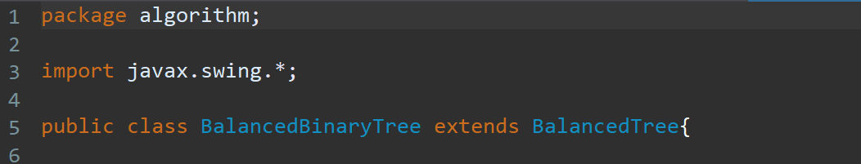
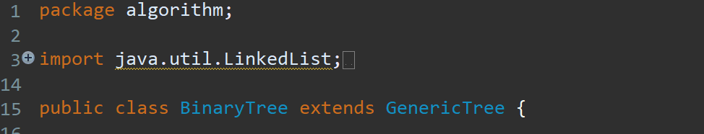
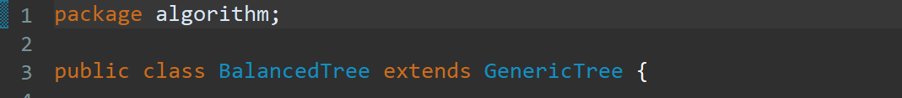
Explanation of OOP techniques
Hierarchical Inheritance
In Hierarchical Inheritance, The GenericTree class serves as a superclass (base class) for more than one subclass. In the below image, class GenericTree serves as a base class for the derived classes BinaryTree, BalancedTree, and BalancedBinaryTree.

Slide 12
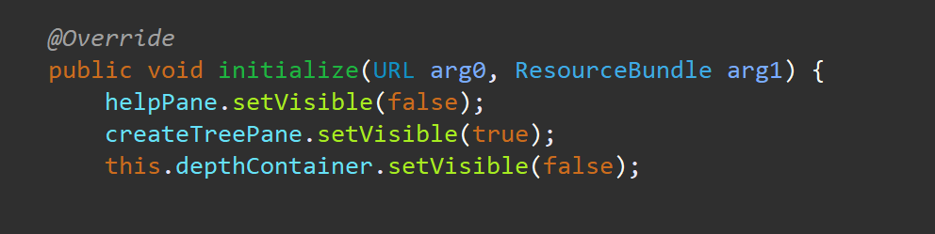
Explanation of OOP techniques
Polymorphism
In the MainController class, the initialize method – which is a method of the class Initializable in JavaFX is overrided.

Slide 13
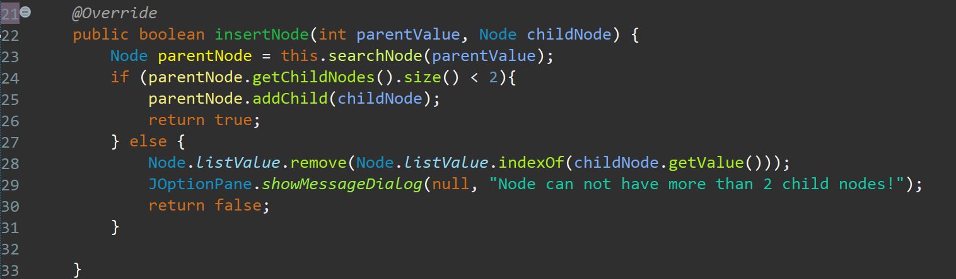
Explanation of OOP techniques
Polymorphism
The insertNode method in the GenericTree class is override in the BinaryTreeClass.

Slide 14

Demo scenario with video link
https://youtu.be/Cfzf-DPqFNs

Slide 15
THANK YOU !

